Slide 1


BANA7025 Group 7 ​ Final Presentation ​
Created by:​
Ethan Ziegler​
Lakshman Duggirala​
Tung Nguyen​
Sreya Pendyala Presented by: Lakshman Duggirala

Slide 2
Introduction
Problem Statement: Our analysis reveals that the 55+ age group generates significantly lower revenue compared to other age demographics when it comes to health-related products based on our 2017 transaction data.​
Why should the CEO be interested? This situation directly impacts our company's overall revenue as we are potentially missing out on substantial income. This demographic typically purchases these products due to their age and health concerns.​
Analytical Methodology Employed: To address this issue, we meticulously cleaned and organized our transaction data. We then conducted in-depth exploratory data analysis and created visual representations to gain valuable insights.

Slide 3
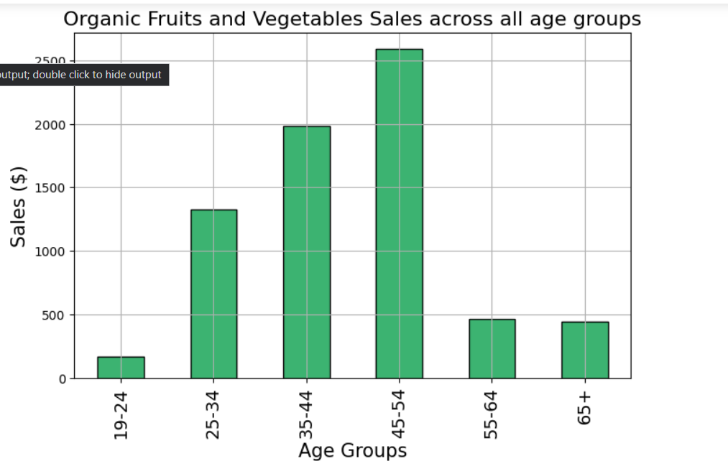
Findings – Organic Fruits and Vegetables Sales
Total Sales for Organic Fruits & Vegetables by Age Group.
Key Insight: The 55+ demographic lags behind in organic product sales compared to other age groups.

Slide 4
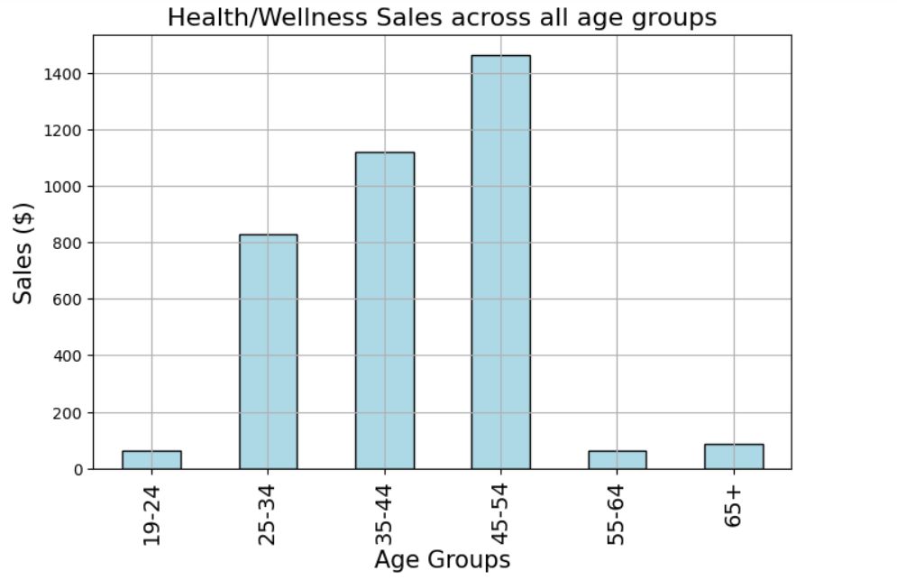
Findings – Health/Wellness Sales across all age groups
Total Sales for Health/Wellness Products by Age Group.
Key Insight: Similar pattern of lower sales in the 55+ demographic for health-related products.

Slide 5
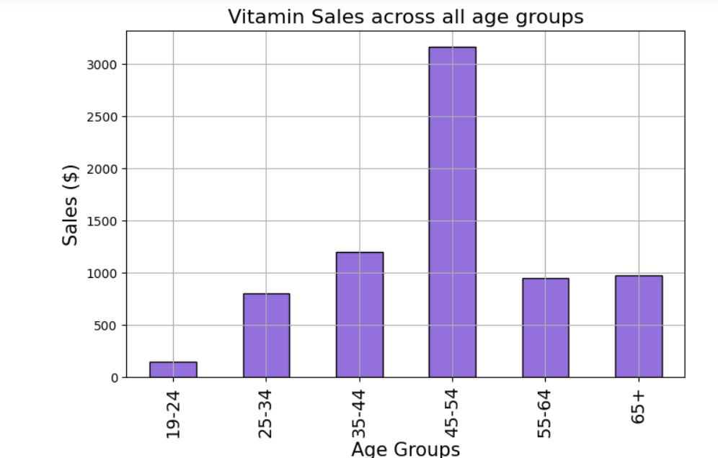
Findings – Vitamin Sales across all age groups
Total Sales for Vitamin Products by Age Group.
Key Insight: The 55+ demographic again shows lower sales for essential health-related items.

Slide 6
Summary
In summary, our analysis reveals a revenue shortfall within the 55+ age demographic, particularly in specific health-related product categories.
To address this issue, we recommend implementing targeted advertising campaigns aimed at this demographic to boost sales. Given their evident need for these products, it's clear that they are not currently making purchases at our stores. Offering coupons or introducing a Senior Citizen discount could be effective strategies to incentivize them to shop with us.
It's important to acknowledge the limitations of our analysis, which is based solely on our company's sales data. We lack comprehensive market data for these specific products, including our market share, which we suspect is currently low. Further exploration into pricing strategies may also be warranted to better cater to this demographic and improve their engagement with our offerings.

Slide 7
Recommendations And Limitations
Targeted Advertising: Focus on 55+ age group through tailored marketing.
Coupons and Discounts: Offer incentives to attract this demographic.
Market Expansion: Explore new strategies to tap into this underserved market.
Data Limitations: Analysis based solely on company sales data.
Market Share Unknown: Lack of overall market data for benchmarking.
Opportunities for Improvement: Consider external data sources for a more comprehensive analysis.

Slide 8
Conclusion
Recap: The 55+ demographic presents a growth opportunity in health-related products.
Next Steps: Implement recommendations to capture this potential revenue.
Overall Impact: Addressing this issue could significantly boost our company's sales and market share.

